Slide 1
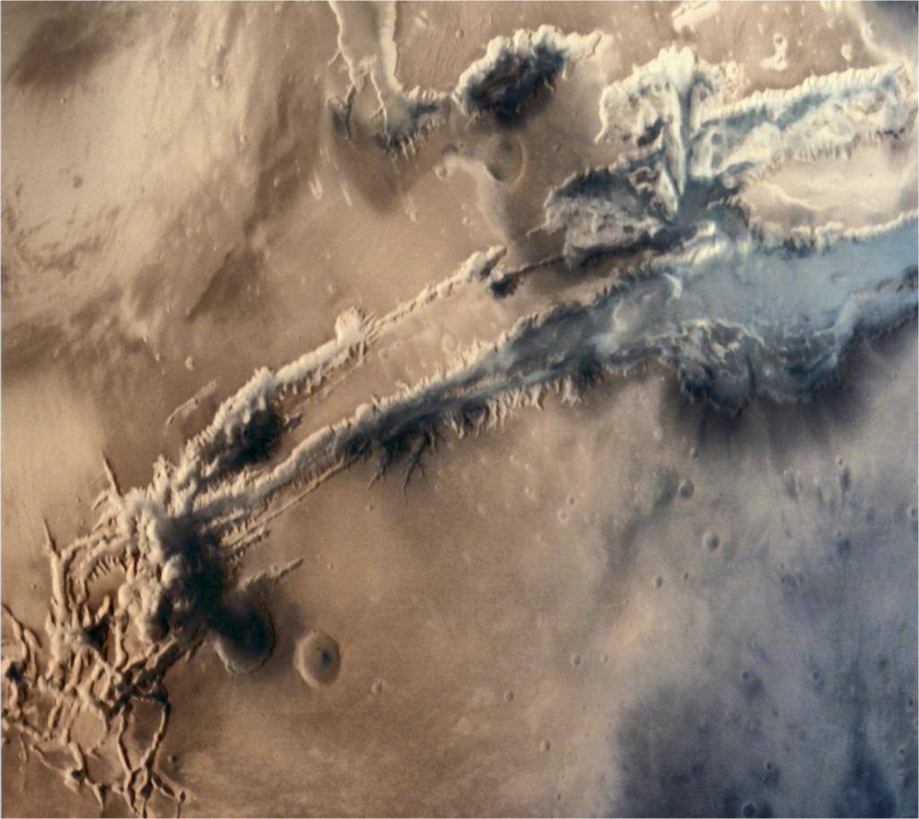
Anomaly Detection Challenge -2 Satellite Image Data
“The Outliers” presents
Nithish Raghunandanan
Vishal Bhalla
Picture: Close-up of grandest canyon of all: Valles Marineris from ISRO's Mars Orbiter

Slide 2
Agenda
Introduction
Data Pre-processing
Rearrangement of the Data
Replacement of Missing Values
System Pipeline
Data Model
Evaluation of the Models
Results
Conclusion
The Outliers - Vishal Bhalla & Nithish Raghunandanan

Slide 3
Introduction
Aim: Classify the central pixel in 3x3 neighbourhoods of a multi-spectral satellite image.
Problem Type: Multi-class Classification
Samples
Training Set: 4435
Test Set: 2000
Number of Attributes: 36 (4 spectral bands x 9 pixels in neighbourhood )
Attributes: The attributes are numerical, in the range 0 to 255.
Classification
There are 6 decision classes: 1,2,3,4,5 and 7.
The Outliers - Vishal Bhalla & Nithish Raghunandanan

Slide 4
Data Pre-processing
Rearrangement of the Data
Given data set had the Spectral Data combined together.
Grouped all the data pertaining to a Spectrum together.
Example
S1.1
S2.1
S3.1
S4.1
S1.2
S2.2
S3.2
S4.2
S1.1
S1.2
S2.1
S2.2
S3.1
S3.2
S4.1
S4.2
The Outliers - Vishal Bhalla & Nithish Raghunandanan

Slide 5
Data Pre-processing(2)
Feature Analysis
Data is in the range of [0,255]
Normalisation not required
Strategies for Replacement of Missing Values
Row Wise
Column Wise
Spectrum Wise
The Outliers - Vishal Bhalla & Nithish Raghunandanan

Slide 6
Data Pre-processing (3)
Replacement Techniques
Zeros & Mid Values
Mean
Median
Mode
Minimum
Maximum
Interpolated Values
The Outliers - Vishal Bhalla & Nithish Raghunandanan

Slide 7
System Pipeline
Data Pre-processing
Model
Analysis of Results
We iteratively used the above pipeline to arrive at the best model
The Outliers - Vishal Bhalla & Nithish Raghunandanan

Slide 8
Model
We tried different types of Multi Class Classification Models to fit our data
One Versus One and One Versus Rest Multiclass Classification
Random Forests
Gaussian , Bernoulli and Multinomial Naïve Bayes Classifier
Multi Class SVM with Linear Kernel
K Nearest Neighbours
The Outliers - Vishal Bhalla & Nithish Raghunandanan

Slide 9
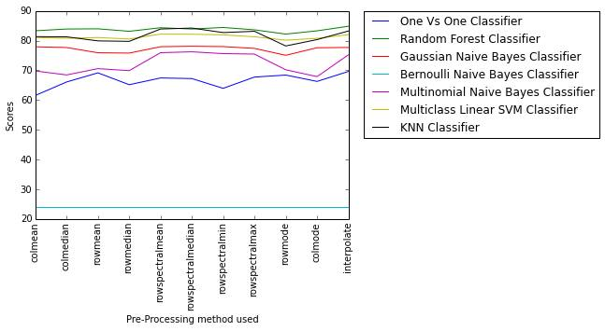
Evaluation of the Models
Criteria
Classification Accuracy on Stratified K-Fold Cross Validation with a split of 4:1.
The Outliers - Vishal Bhalla & Nithish Raghunandanan

Slide 10
Results
Model | Replacement Technique | Classification Accuracy (Public Score) | Classification Accuracy (Private Score)
Random Forest (50 trees with Entropy) | Row Spectral Median | 0.89800 | 0.92100
Random Forest (50 trees with Gini) | Row Spectral Median | 0.89300 | 0.92400
KNN with 3 neighbours | Row Spectral Median | 0.89200 | 0.90500
Random Forest(Gini) | Interpolation | 0.89000 | 0.91800
KNN with 3 neighbours | Row Spectral Mean | 0.89000 | 0.89700
KNN with 3 neighbours | Column Mean | 0.87800 | 0.89900
Multi-class Linear SVM | Row Spectral Median | 0.84000 | 0.85900
The Outliers - Vishal Bhalla & Nithish Raghunandanan

Slide 11
Conclusion
The best results were observed for Random Forest (50 trees with Entropy as a criterion) on rearranged data and using row spectral median values for missing values.
Replacement of missing values by Row Spectral Median values gave consistently better results across all of our models.
The Outliers - Vishal Bhalla & Nithish Raghunandanan

Slide 12

Questions?
The Outliers - Vishal Bhalla & Nithish Raghunandanan

Slide 13
Thank You !
The Outliers - Vishal Bhalla & Nithish Raghunandanan

